Slide 1

Final Thesis Presentation
INVESTIGATION ASSISTANT WITH SUSPECT ANTICIPATING INTELLIGENCE
Farah Idid Nibir (15301080)
Saqueeb Abdullah (18241029)
Suraiya Salam (14101130)
Akash Dey (15201029)
Department of Computer Engineering
BRAC University
Supervisor: Dr. Md. Ashraful Alam

Slide 2
Outline
Introduction
Motivation, Objective
Thesis Orientation and Fundamentals of ML
Literature Review
Limitations in existing models
Proposed Model
Data Processing
Feature and Label Extraction
Feature Scaling
Model Training and Testing
Dataset Demonstration
System Implementation
Results Analysis and Performance Evaluation
Comparison with Conventional Methods
Conclusion
References
Response to the Comments on Thesis Report

Slide 3
Introduction
Motivation.
Objective .
Thesis Orientation.
Fundamentals of Machine Learning

Slide 4
Existing Methods
An existing System called “Criminal investigation” is Data Mining process, which offers the criteria of
Primary Suspect Prediction.
Keeping the Criminal Back Ground Record.
A Discriminative model was proposed in order to generate the proposed solution.
Decision Tree Algorithm

Slide 5
Existing Methods
“Introduction to Criminal Investigation: Processes, Practices and Thinking” a book was published in 2017 by Rod Gehl
Criminal investigation as a thinking process
Precautions of Investigation

Slide 6
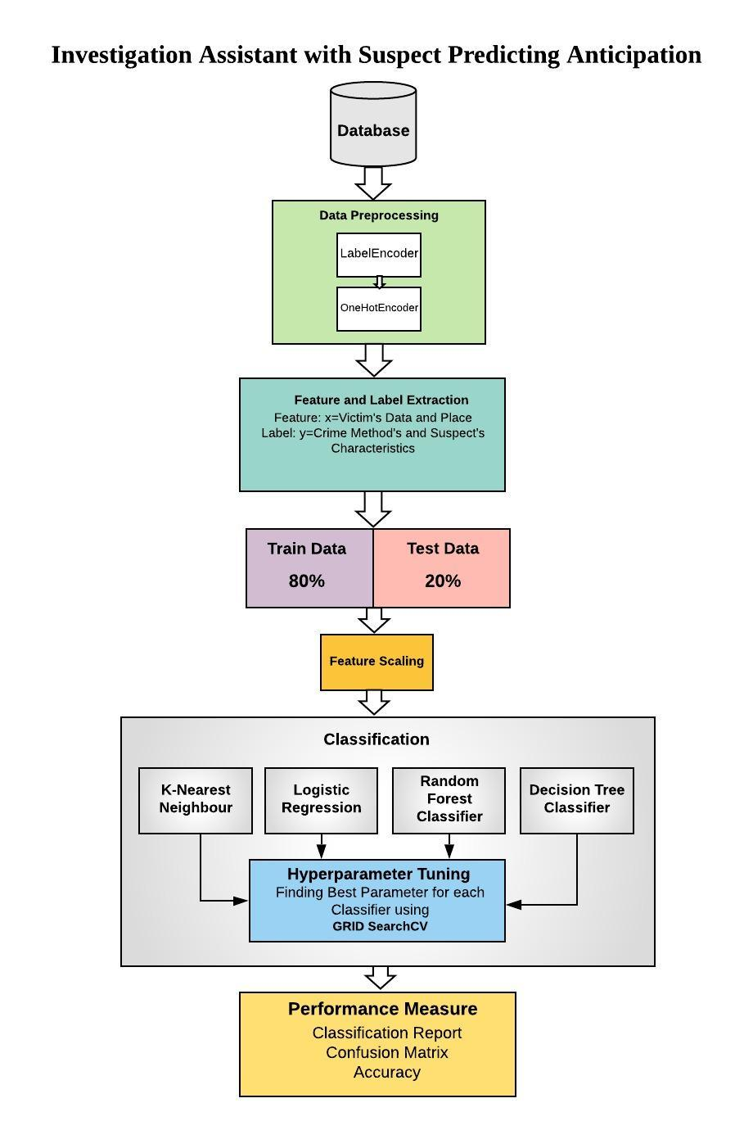
Proposed Method
The flow diagram of the proposed method

Slide 7
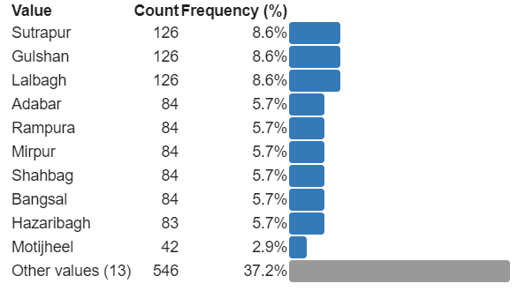
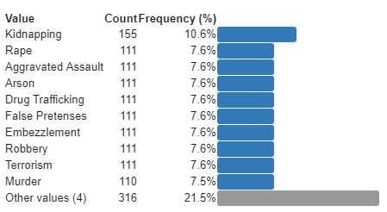
Dataset Demonstration
Area of the Crimes
Crimes
Fig. 4.1 Area of the Crimes (Categorical)-Feature
Fig. 4.2 Crimes (Categorical)-Feature

Slide 8
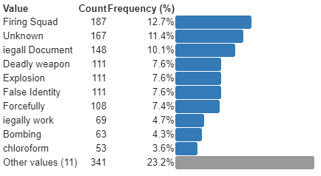
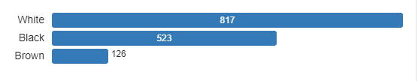
Dataset Demonstration
Method of those Crimes:
Race
Fig. 4.3 Method of Crime (Categorical)-Label
Fig. 4.4 Race (Categorical)-Feature for Victim, Label for Criminal

Slide 9

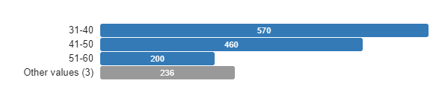
Dataset Demonstration
Sex
Criminal Name:
Distinct count | 1452
Unique (%) | 98.8%
Missing (%) | 0.0%
Missing (n) | 0
Fig. 4.5 Sex (Categorical)-Feature for Victim, Label for Criminal
Fig. 4.6 Criminal Name (Categorical)
Age Range
Fig. 4.7 Age Range (Categorical)

Slide 10
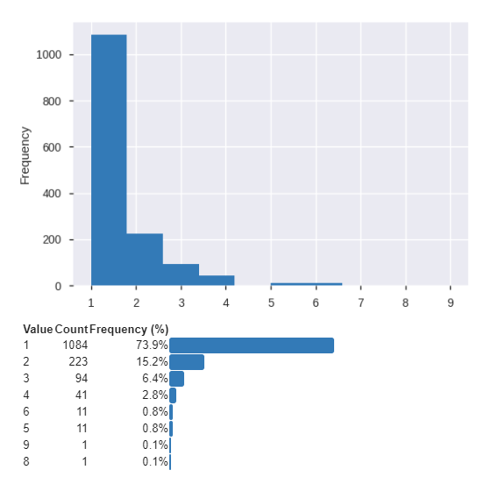
Dataset Demonstration
Victim Count:
Fig. 4.6 Victim Count (Categorical)

Slide 11
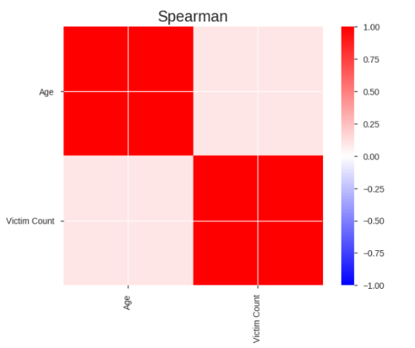
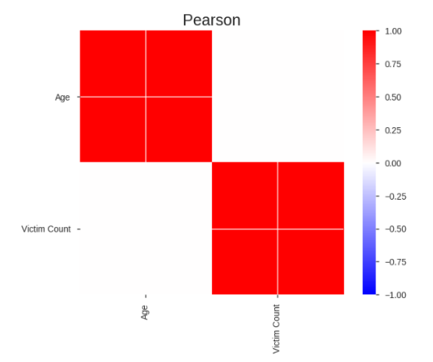
Dataset Demonstration
Correlations:
Fig. 4.8 Pearson Correlation
Fig. 4.8 Spearman Correlation

Slide 12
Feature Extraction
Features
Victim Count | Victim Sex | Victim Race | Crime | Area
1 | Male | Black | Murder | Badda
2 | Female | Latino | Terrorism | Lalbagh
Labels
Age Range | Sex | Race | Method
41-50 | Male | Black | Electrocution
21-30 | Male | White | Deadly Weapon

Slide 13
Data Preprocessing
Data Cleaning > Missing Data 1. Ignore the tuples
2. Fill the Missing Values
Label Encoder
OneHotEncoder
Feature Scaling

Slide 14
Train-Test Split
80%
20%
Train
1176
Test
294

Slide 15
System Implementation
NB
AdaBoost
LR
ANN
KNN
SVM
RFC
DTC
GridSearchCV
Classifiers

Slide 16
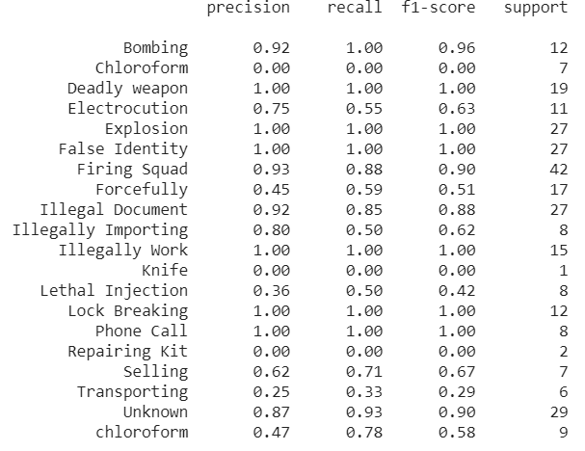
Performance Evaluation & Experimental Results
Predicting Crime Method in a Given Victim’s Characteristics
Best Performed Classifier: Random Forest Classifier
Best Parameters: 'criterion': 'entropy', 'n_estimators': 30
Accuracy: 83.333%
Figure: Classification Report

Slide 17
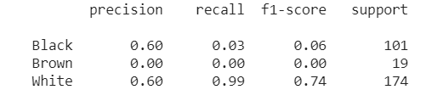
Continues
Results of Predicting Race of the Criminal in a Given Victim’s Characteristics
Best Performed Classifier: Artificial Neural Network
Best Parameter: 'activation': 'relu', 'learning_rate': 'adaptive', 'max_iter': 150, 'solver': 'sgd'
Accuracy: 76.531%
Figure: Classification Report

Slide 18
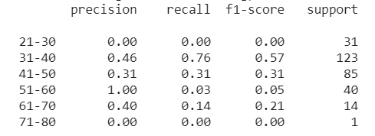
Experimental Results
Results of Predicting Age Range of the Criminal in a Given Victim’s Characteristics
Best Performed Classifier: Support Vector Machine
Best Parameter: 'C': 0.3, 'decision_function_shape': 'ovo', 'kernel': 'poly'
Accuracy: 65.646%
Figure: Classification Report

Slide 19

Experimental Results
Results of Predicting Sex of the Criminal in a Given Victim’s Characteristics
Best Performed Classifier: Decision Tree Classifier
Best Parameter:'C': : 'criterion': 'gini', 'max_depth': 60, 'min_samples_split': 5, 'splitter': ' random'
Accuracy: 99.66%
Figure: Classification Report

Slide 20
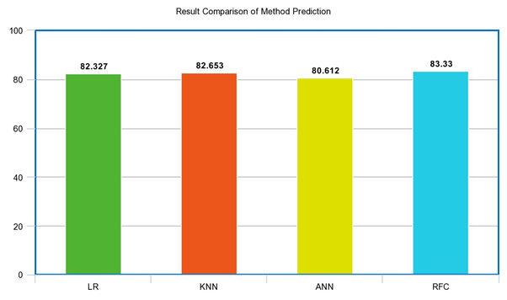
Comparison with Proposed Model With Other Algorithms
Model of Predicting Crime Method
compared with three other Classifiers
Classifiers | Logistic Regression | K-Nearest Neighbor | Artificial Neural Network | Random Forest Classifier
Accuracy | 82.653% | 82.327% | 80.612% | 83.333%
Diagram: Method Prediction Comparison with Logistic Regression, K-Nearest Neighbor, Artificial Neural Network, Random Forest Classifier

Slide 21
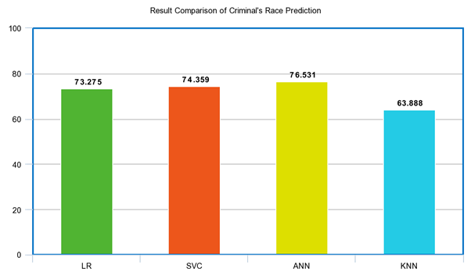
Continues
Model of Predicting Criminal’s Race
compared with three other Classifiers
Classifier | Logistic Regression | Support Vector Machine | Artificial Neural Network | K-Nearest Neighbor:
Accuracy | 73.275% | 74.359% | 76.531% | 63.888%
Diagram: Method Prediction Comparison with Logistic Regression, K-Nearest Neighbor, Artificial Neural Network, Random Forest Classifier

Slide 22
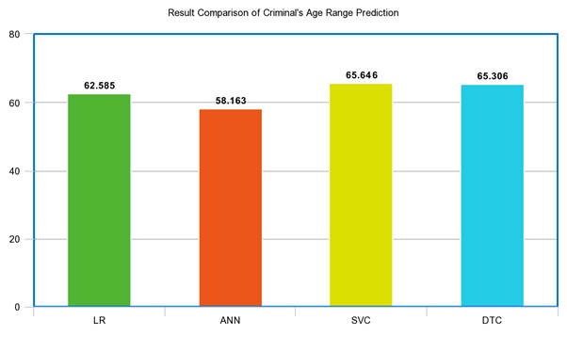
Continues
Model of Predicting Criminal’s Age Range
compared with three other Classifiers
Classifier | Logistic Regression | Artificial Neural Network | Support Vector Machine | Decision Tree Classifier
Accuracy | 62.585% | 58.163% | 65.646% | 65.306%
Diagram: Age Range Prediction Comparison with Logistic Regression, Artificial Neural Network, Support Vector Classifier, Decision Tree Classifier

Slide 23
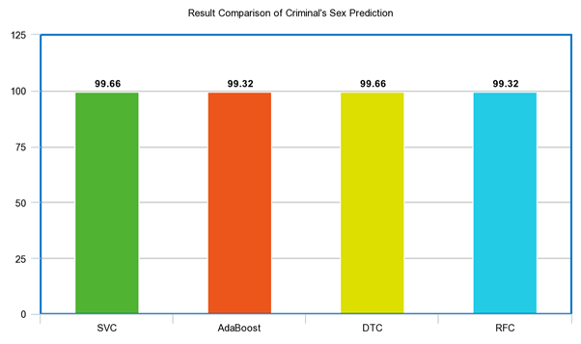
Continues
Model of Predicting Criminal’s Sex
compared with three other Classifiers
Classifier | Support Vector Machine | AdaBoost Classifier | Decision Tree Classifier | Random Forest Classifier
Accuracy | 99.660% | 99.320% | 99.660% | 99.320%
Diagram: Sex Prediction Comparison with Support Vector Machine, AdaBoost, Decision Tree Classifier, Random Forest Classifier

Slide 24
Limitations
Dealing with small dataset
Collecting the criminal dataset from Bangladesh Police Department
Victim identification problem
HyperParameter Optimization is time consuming

Slide 25
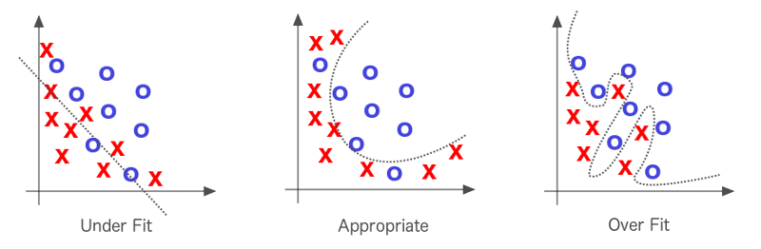
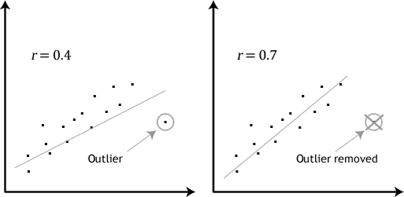
Limitations
Dealing with small dataset:
Small dataset may lead to overfitting
Beware the outliers

Slide 26
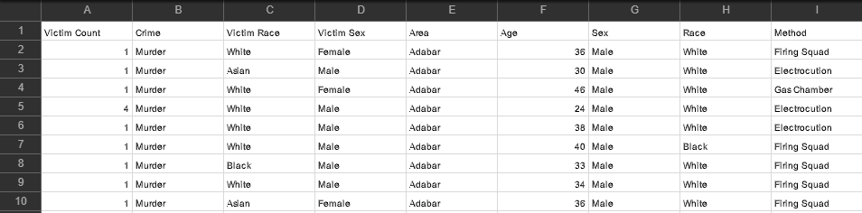
Limitations
Collecting the Dataset from Bangladesh Police Force:
Provided confidential dataset anonymously

Slide 27
Limitations
Lack of Information regarding victim characteristic:
Absence of features prevent our systems from getting the better results
Hyperparameter Optimization is time consuming
Brute force approach tests all possible combination

Slide 28
Conclusion and Future Work
Picture Search Option
NID database linkup with our system
“Image Evidence Analysis” feature by Image processing
Implement web-based and Android application

Slide 29
References
[1] Plecas, R. G. (2017). Introduction to Criminal Investigation: Processes, Practices and Thinking. Darryl Plecas, University of the Fraser Valley: BCcampus.
.
[2] Akash Desai, G. (2017). Criminal Investigation Tracker with Suspect Prediction. IJESC.
[3] Nitin Sakhare, S. J. (2014). Criminal Identification System Based On Data Mining. Recent Trends in Engineering & Technology (p. 1). 2014: Elsevier Publication
[4] Data Preprocessing in Data Mining - GeeksforGeeks. (n.d.). Retrieved from GeeksforGeeks: https://www.geeksforgeeks.org/data-preprocessing-in-data-mining/
[5] Raheel, S. (2018, November 9). Choosing the right encoding method- Label vs OneHot Encoder. Retrieved from Towards Data Science:
https://towardsdatascience.com/choosing-the-right-encoding-method-label-vs-onehot-encoder-a4434493149b
[6] What is One Hot Encoding? Why and when do you have to use it? (n.d.). Retrieved from Hackernoon: https://hackernoon.com/what-is-one-hot-encoding-why-and- when-do-you-have-to-use-it-e3c6186d008f
[7] Bronshtein, A. (2017). Train/Test Split and Cross Validation in Python. Understanding Machine Learning.
[8] Dataaspirant. (2017). Retrieved from Dataaspirant: https://dataaspirant.com/2017/01/30/how-decision-tree-algorithm-works
[9] Pupale, R. (2018). Support Vector Machines(SVM) — An Overview. Retrieved from Towards data science: https://towardsdatascience.com/https-medium-com- pupalerushikesh-svm-f4b42800e989
[10] Classification Report - yellowbrick 0.9.1 documentation. (2016). Retrieved from Yellow Brick: https://www.scikit- yb.org/en/latest/api/classifier/classification_report.html

Slide 30
References
[11] Bhandari, I., Colet, E., Parker, J., Pines, Z., Pratap, R., & Ramanujam, K. (1997, March). Advanced Scout: Data Mining and Knowledge Discovery in NBA Data. Data Mining and Knowledge Discovery, 121-125.
.
[12] Brian, S. (2012, January 25). The Problem of Shot Selection in Basketball. PLoS One.
[13] Choudhury, R. D., & Bhargava, P. (2007). Use of Artificial Neural Networks for Predicting the Outcome. International Journal of Sports Science and Engineering, 1(2), pp. 87-96.
[14] Duckworth, F., & Lewis, T. (1999). Your Comprehensive Guide to the Duckworth/Lewis Method for Resetting Targets in One-day Cricket. University of the West of England.
[15] Plecas, R. G. (2017). Introduction to Criminal Investigation: Processes, Practices and Thinking. Darryl Plecas, University of the Fraser Valley: BCcampus.
[16] Sankaranarayanan, V. V., Sattar, J., & Lakshmanan, L. S. (2014). Auto-play: A data mining approach to ODI cricket simulation and prediction. SIAM International Conference on Data Mining, (p. 1064).
[17] Tulabandhula, T., & Rudin, C. (2014). Tire Changes, Fresh Air, and Yellow Flags: Challenges in Predictive Analytics for Professional Racing. Big data.
[18] What is Data Preprocessing? - Definition from Techopedia. (n.d.). Retrieved from Techopedia: https://www.techopedia.com/definition/14650/data-preprocessing

Slide 31
THANK YOU!

Slide 32
Response of the Comments on the Submitted Thesis Reports

Slide 33
Comments and Suggestions by RAA
Q-1. Proper Representation of the Documentation
The documentation has been Revised based on the comments and suggestions.
Q-2. Re Organize the format of the paper as given by Department of CSE
The format of the paper was reorganized by following the templet on the University Website.
Q-3. Change the reference Format
All the References are now in IEEE Format.
Q-4. Figure Number and Table Number
We have labeled all the figure and Table number.
Q-5. Complete The Report.
All the comments have been reviewer and fixed accordingly.

Slide 34
Comments and Suggestions by MRA
Q-1. Correction in the Declaration Section.
The marked word has ben changed to “Thesis Report”
Q-2. Finish the Abstract in one Paragraph.
The abstract paragraph is now a single paragraph.
Q-3. Change the way of Reference
All the References are now in IEEE Format
Q-4. Why there is Unnecessary space?
All the Un-necessary Spaces were reduced.
Q-5. Avoid too large paragraph.
Too large paragraphs have been précised and reviewed.
Q-6. Figure Number and Table Number
We have labeled all the figure and Table number.
Q-7. Where is the equation of Precision, Recall and F1 Score
Precision, Recall and F1 Score generalized equation have been added.

Slide 35
THANK YOU!

